Slide 1
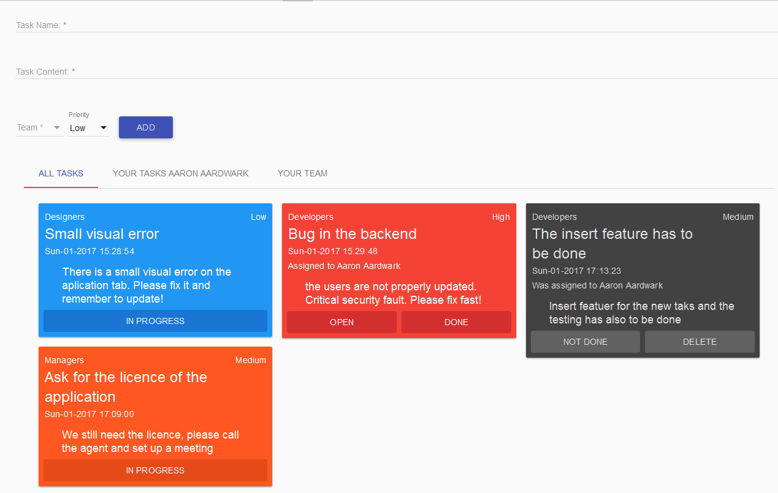
Task Web App Tracking
Teams have trouble managing tasks
Who does what
What is important
What has to be done
Task Web App Tracking solves this problem
Users can create tasks
Users can take and work on tasks
Users know what tasks are in progress
Users know what tasks are important

